Slide 1
v
PORTFOLIO
——technology focused
The Work of Haoyi Xu
2022

Slide 2
CONTENT
Games Made With Unity/Unreal
Shader Effects
My Tiny Renderer
The Grapple Robot

Slide 3


01
Games Made With Unity/Unreal
As a student majoring in computer science and technology, I gradually became interested in game making during my four years in college. Since my sophomore year, I have cooperated with art majors and used unity engines or unreal engines to make various games. The following three games are part of them.
P.S. So far, I have been solely responsible for all the programming parts of the games I worked on.

Slide 4
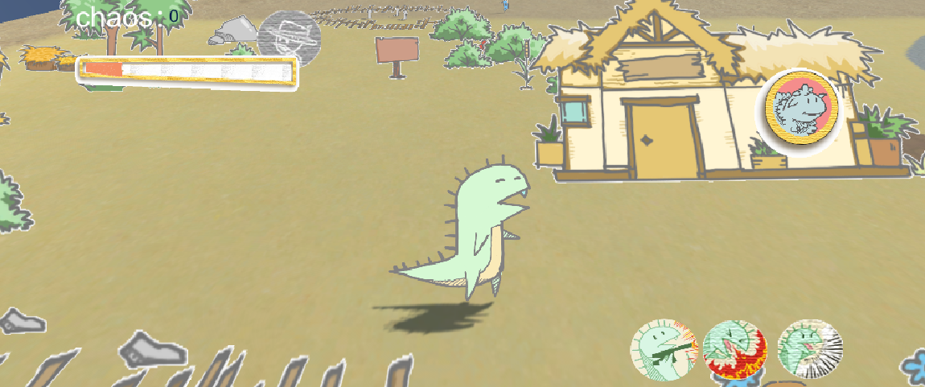
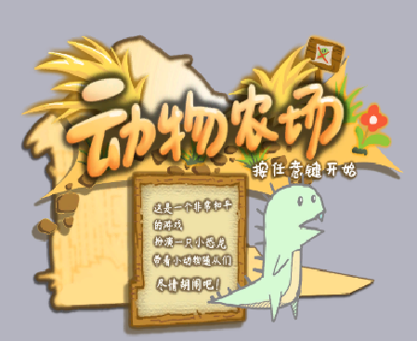
Animal Farm——Overview
Our team consists of five members, two of them are responsible for the planning of the game, two are responsible for the art of the game, and I am responsible for all the programming work using the unity engine. In total, it took our team about two months to complete all the games.
Animal Farm is a 2.5d role play game. Its gameplay is inspired by the game——’just die already’, and its plot is inspired by the novel of the same name. In the game, the player plays a small dinosaur that destroys everywhere. By defeating the farmers, you can free all kinds of small animals. These small animals will follow the protagonist to continue to conquer the farm. When enough chaos value is accumulated, they will enter the boss battle. When our protagonist and other animals defeat the boss, it is considered a victory.

Slide 5
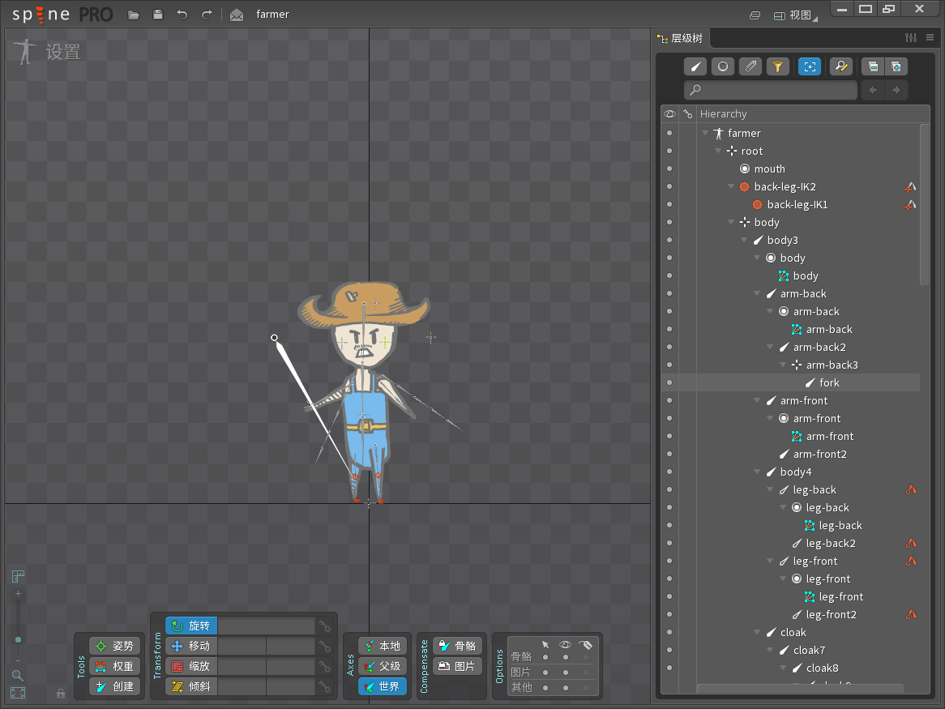
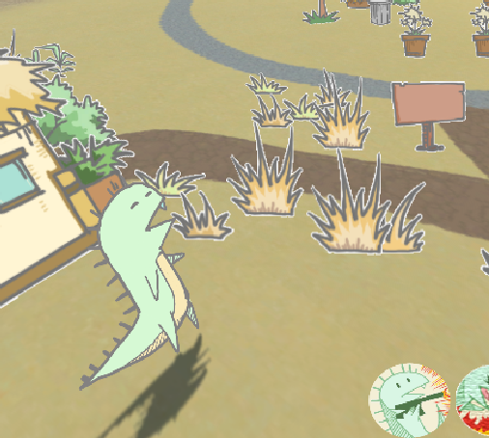
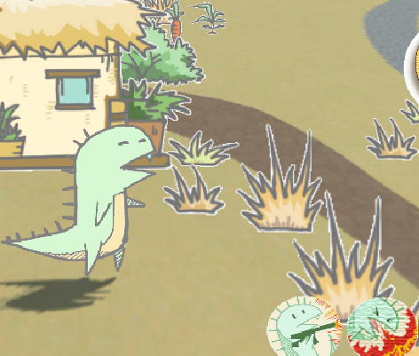

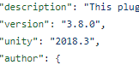

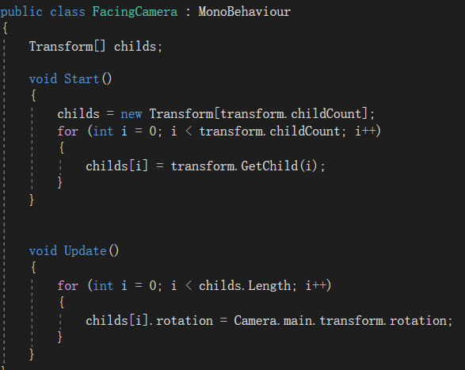
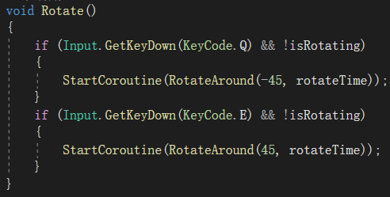
Animal Farm——Spine & 2.5d
I implemented 2.5d using the technique named “billboard” and ended up with a similar effect to the game Don‘t Starve Together – where the player can rotate the camera with q, e, and some gameobjects will always face the camera.
The animation is made using spine instead of frame animation in unity, so as to achieve a smoother connection effect, which can be better combined with blended tree. In the process of importing art resources, I also encountered some problems, including unity prompting version mismatch, and finally I solved this problem by changing the json file.

Slide 6
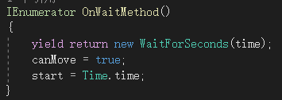
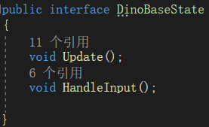
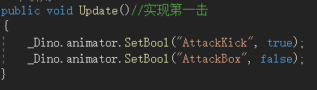
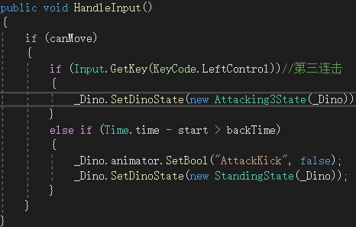
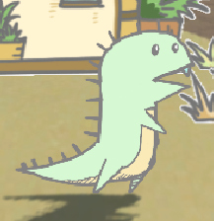
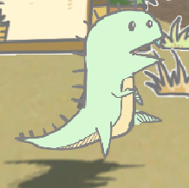
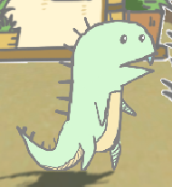
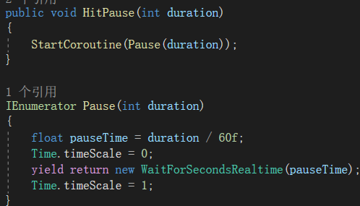
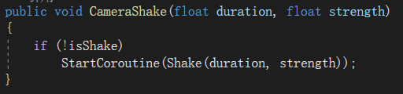
Animal Farm——triple attack & strike feedback
I used the inite-state machine (fsm) to realize the triple attack. Firstly, I used the interface to construct the abstract class of the attack, and secondly, each attack was used as a separate class to implement this interface and fill in the corresponding settings.
Single class
interface
I use three methods to achieve perfect hit feedback, which is camera shake, freeze frame and use post-processing by image-effect shader to change the picture effect.

Slide 7
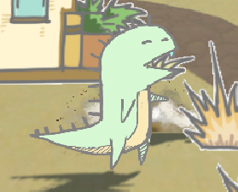
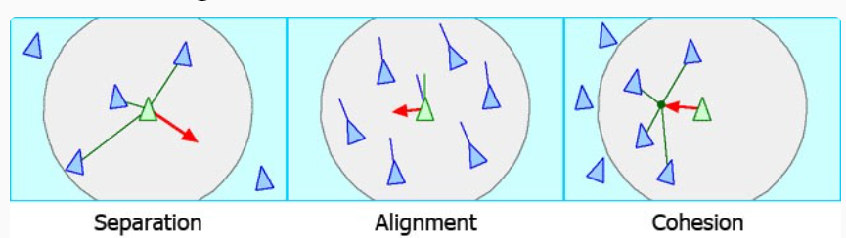
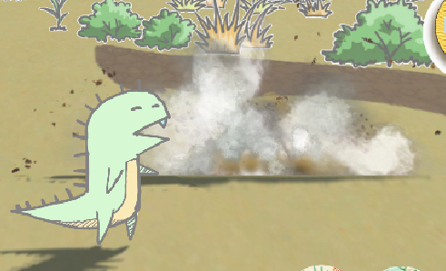
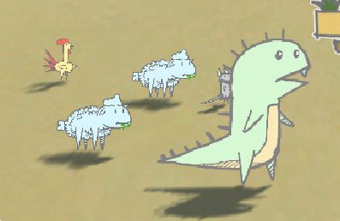
Animal Farm——flocking algorithm & destroy system
After the player defeats the farmer, breaks the railing, and rescues the animals, the animals will follow and fight with the player. I use a flocking algorithm to make the critters follow the player more harmoniously.
Flocking algorithm consists of the following three pasts.
Most objects in the scene can be destroyed, and different objects correspond to different explosion methods. I achieve this effect through instantiating the prefab made with animation.
Feel free to see the whole project here: https://github.com/derkder/AnimalFarm

Slide 8
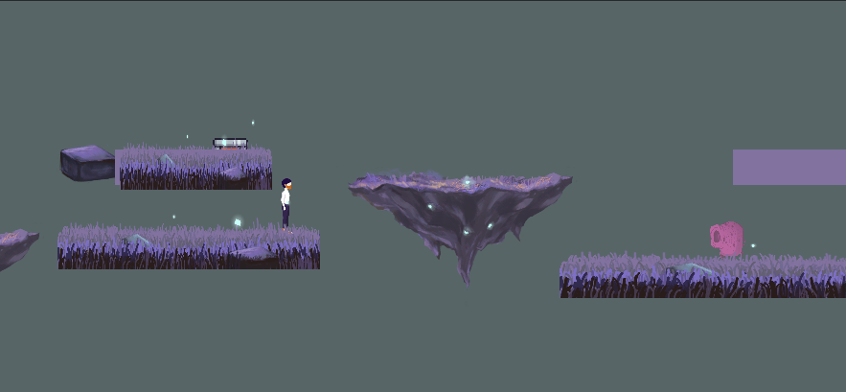
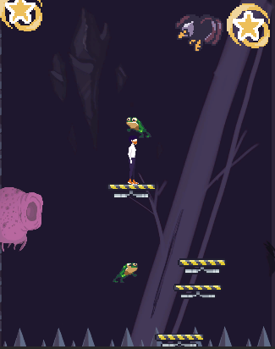
Light & Mirror——Overview
Our team consists of three people, one is responsible for art and the other is responsible for planning games. I am responsible for all the programming works by unity engine.
We made this game when we were involved in gamejam. The theme of this gamejam is 20xx, so we made such a cosmic style game. The world in the game is divided into two worlds, the above-ground and the underground. In the above-ground world, the player obtains the key to the underground by decrypting and defeating the enemy. In the underground world, the player avoids the enemy and landed in a suitable position to obtain the skill chip. In the end, the player defeats the enemy who uses the barrage attack as victory.

Slide 9
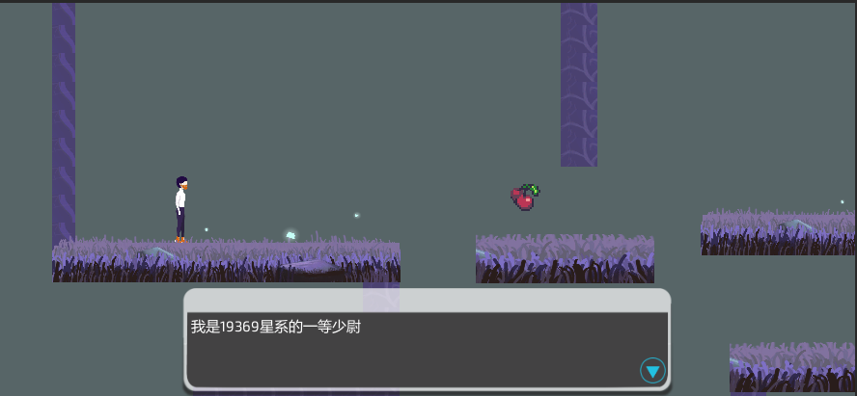
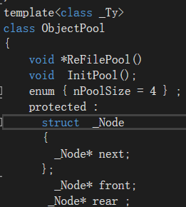
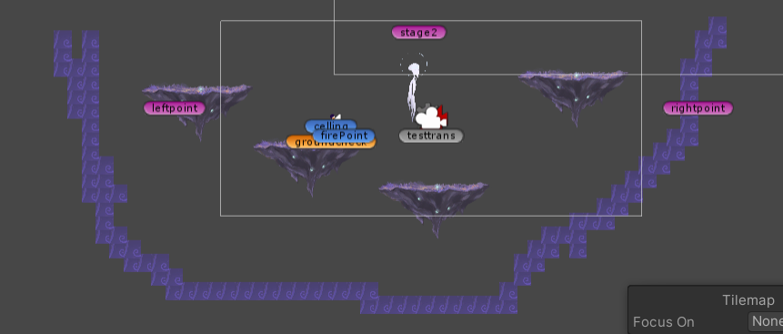
Light & Mirror——Details
I use tilemap to build the scene to achieve pixel style. Use the fungus plugin to make in-game dialogue and plot choices. Use the list in c# to generate the platform, and add additional judgment to ensure that there will be no situation where the player encounters two dangerous platforms in a row and cannot pass the level. Inheritance is also used to make different kinds of enemies, so that each enemy has its own different attributes.
In order to realize the barrage attack, I used the singleton mode combined with the objectpool to generate the boss's attack bullets. Thereby reducing performance consumption, making the picture more smooth.

Slide 10
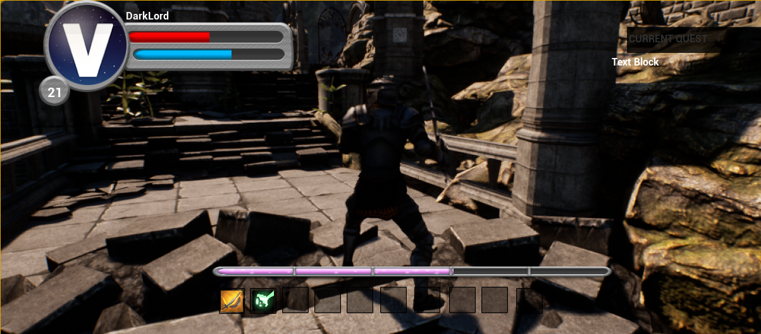
Before this, my games were all made with unity engine, and this game was made by myself with the unreal engine, which is also an exploration of a new engine.
Disenchanted——Overview
The name of the game comes from a song by my favorite band, My Chemical Romance. In the game, players can switch between the swordsman and the magician, so as to use their respective skills to solve the corresponding level, destroy the enemy, and finally rescue the baby dinosaur in the dungeon to win the game.

Slide 11
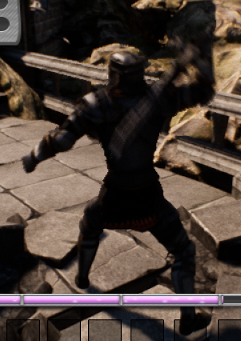
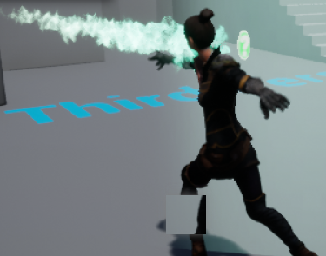
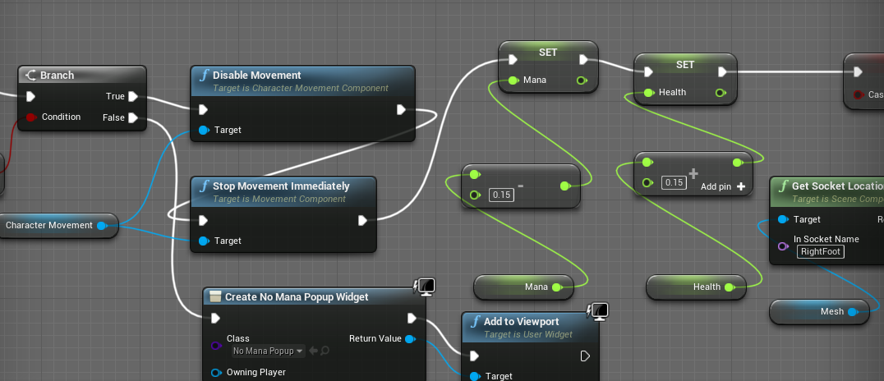
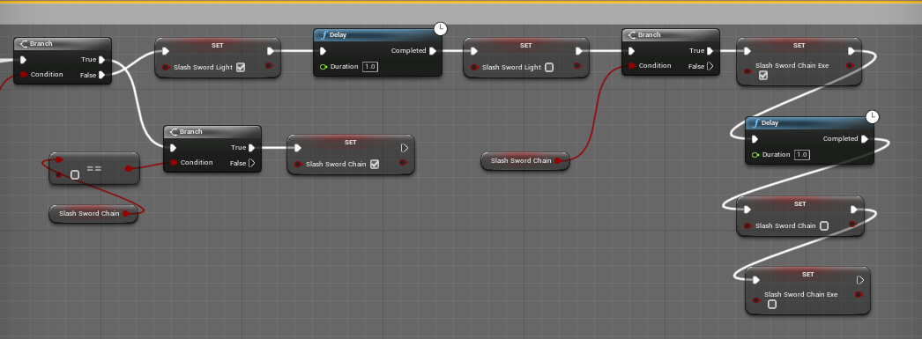
Disenchanted——Characters
The magician can restore health and launch fireballs by consuming mana, which is more suitable for using fireballs to solve puzzles or drain the enemy's blood.
The Swordmen have stronger attack power and are more suitable for facing aggressive enemies. Swordsman has the attack system of Japanese fighting games, which can light attack, heavy attack, triple attack , jump attack and defend.

Slide 12
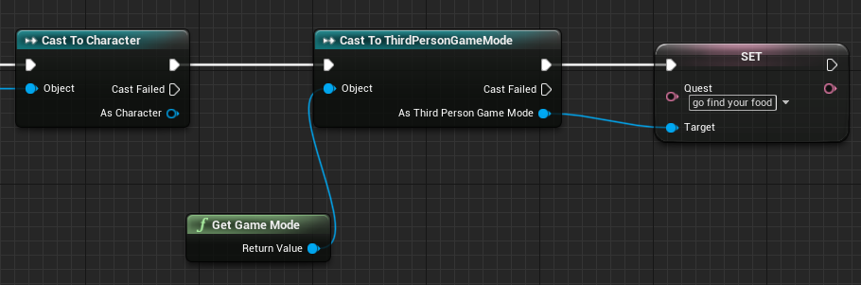
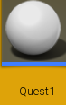
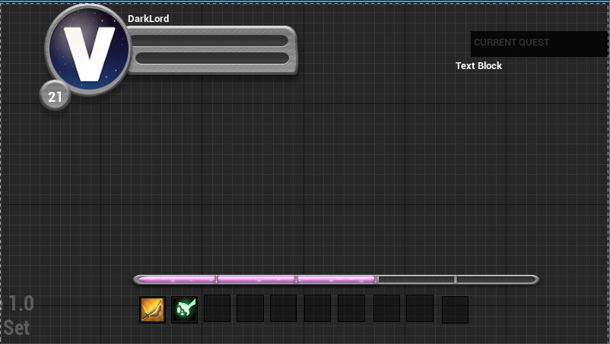
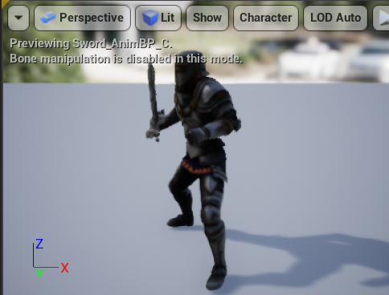

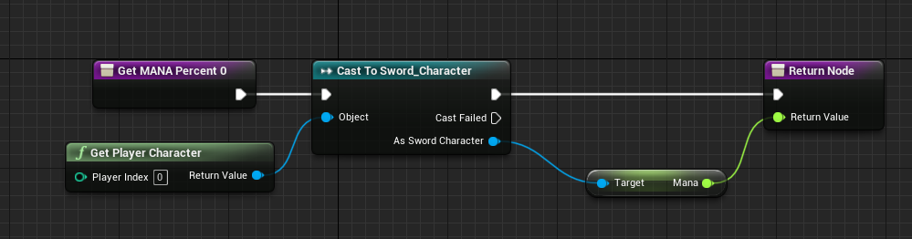
Disenchanted——Details
At the same time, the game has a relatively complete hud interface, which displays the player‘s health, mana, current experience value and skill cooldown, as well as the task to be completed.
The game also has a mission system. Players will receive different missions by defeating enemies or reaching designated places.
The swordsman and the sword are connected by a socket, and more interactive actions of the swordsman are realized through the blended tree.

Slide 13
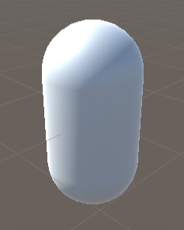
02
Shader Effects
In addition to making games, I'm also very interested in computer graphics. In the process of learning, I have put the relevant knowledge into practice. Here will show some graphic effects I made using shader lab in unity engine.

Slide 14
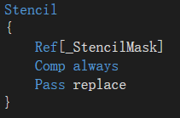
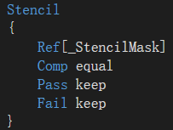
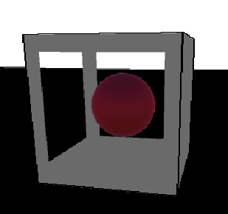
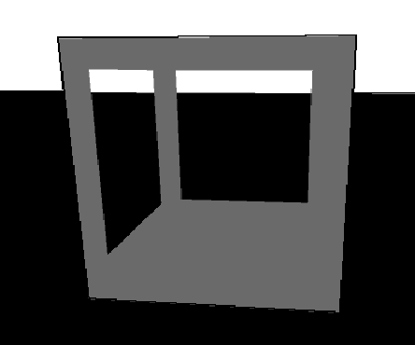
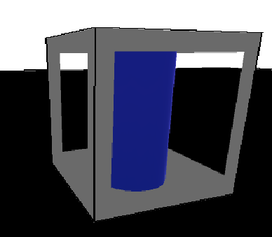
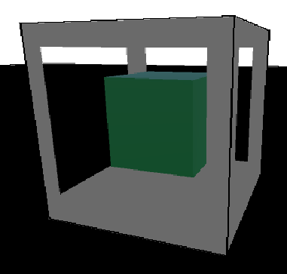
Non-Euclidean Cubes
mask
object
When I play moncage, I can‘t help but start thinking about how to achieve the same effect inside —— non-Euclidean cubes.
Non-euclidean cubes refer to different scenes when the player looks at the same square from different sides of the scene, they see different scenes.
After the follow-up study of graphics and the unity engine, I thought of two ways to implement it. The first is to use the rederertexture to connect different scenes to different planes, and the second is to use the stencil test in the shader to set different stencil buffers on different sides of the block. In the scenario below, the latter is used here.

Slide 15
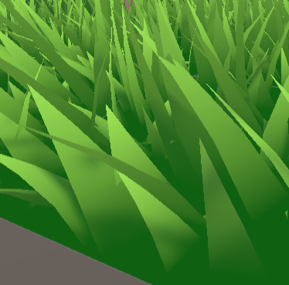
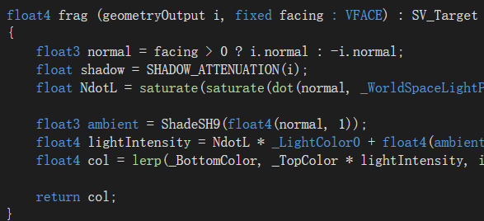
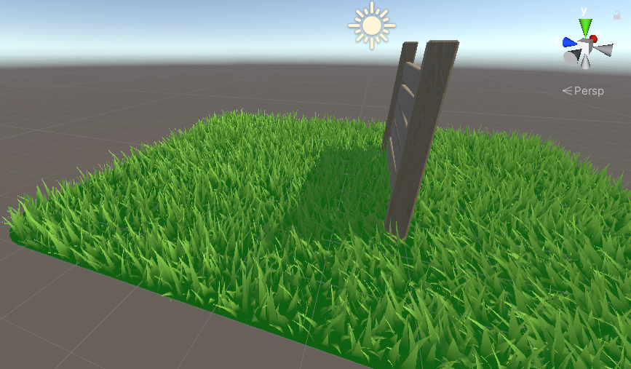
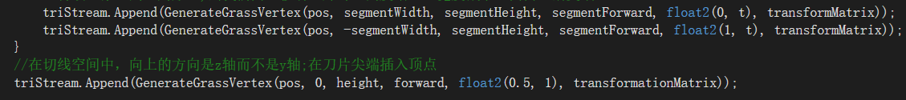
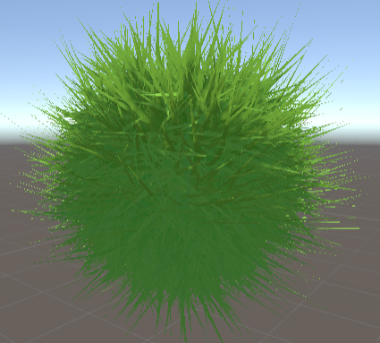
Geometry Shader & Tessellation
Interactive Grass
The game above - Animal Farm led me to explore interactive grass making. Here I use shaders to make grass that has shadows as well as has the ability to move in the wind and interact with our player (using particle system and renderer texture).
Tangent Space
After generally achieving the desired effect, I found that the generation of grass on uneven surfaces was strange. To solve this problem, I changed to use tangent space to generate grass.

Slide 16

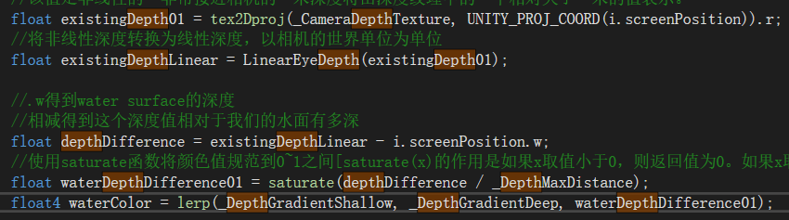
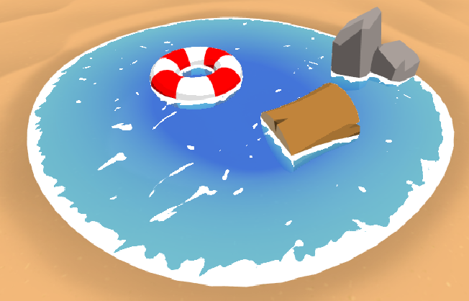

Toon Water
Depth Testing
By calculating the distance between the camera and the ground, combined with the depth test, the depth of the water color is calculated to show the depth of the water.
While playing Zelda, I started to wonder about how the rendering effect inside —— cartoon rendering is done. This is how the toon water here comes from. The toon water here uses Berlin noise to create water flow disturbances as well as has the ability to show the depth of the water and generate foam effect.
Foam Effect
I use the dot product to control the amount of foam

Slide 17

03
My Tiny Renderer
After working with shaders, I started to explore the area of computer graphics further. After a period of learning, I tried to build a tiny soft renderer myself and tried out the ray-tracing algorithm.

Slide 18





My Tiny Soft Renderer
Overview: The renderer uses rasterization to render images. The renderer converts .obj files to .tga files. By changing the functions inside the renderer, users can also achieve different rendering effects.
In the renderer, I use the lighting model to calculate the light intensity of each fragment to get the shading effect. Here we use the Bling-Phong lighting model, which is mainly composed of the following three parts
Use z-buffer to calculate depth, and use centroid interpolation to expand from points to triangle primitives.

Slide 19







My Tiny Soft Renderer
The camera can be seen as an ideal focal point in the animation engine and has a rectangular virtual photosensitive surface - an imaging matrix, where each photosensitive element corresponds to a pixel in the screen. The three most important steps are perspective projection, perspective rotation and perspective correction.
I also rearranged the code to make the rendering process divided into two parts: vertex transformation and shading. In this way, the shading part becomes a programmable form, that is, users can edit the shader to achieve the different renderings mentioned above.
Texture: With the light intensity, we also need an RGBA value to fully draw a fragment. This uses the previous uv coordinates in .obj. When drawing a triangle, we find the corresponding value of the UV value corresponding to the pixel on the texture image, and then we can set the corresponding color.

Slide 20





Ray-Tracing
Overview:
Ray tracing is to send rays from our eyes to each pixel, determine whether these rays intersect the sphere in order to get the color of the pixel.
The above renderer uses rasterization to render models. After a period of study, I also explore the use of ray tracing to render graphics.
Shadow & Reflection:
Refrection:
I use Snell‘s Law Formula to calculate refraction

Slide 21

04
The Grapple Robot
In addition to making games, I have also explored a lot of other areas with my programming skills, such as using neural networks to make investment plans, using Andriod Studio to develop an app that reminds you to water your plants, and my favorite, programming grapple robots.

Slide 22


Overview
Our team designed and made a fighting robot with intelligent judgment and powerful functions such as patrol and attack. It is designed to knock the opponent off the ring during the arena competition.
In our team, three other students are responsible for designing the mechanical structure and 3D printing the body, and I am responsible for all the programming works to control the robot through various sensors.

Slide 23



Robot Control
I programmed the robot to collect information through various sensors, send it to the luby controller, and process the data to reach our goal by graphical programming combined with c language.
I use the above software to test the bending angle of the servo and the data from the infrared sensor and grayscale sensor. From these tests and data, I wrote code to determine the robot's performance in real time based on the values returned by the sensors

Slide 24




Function Modules
Attack
Go Onstage
When it detects obstructions on both sides of the car , first hit the rear at a medium speed to adjust the direction, then drive straight forward for a certain distance and back up at full speed while pressing down the front shovel.
When an enemy is detected, I get the D-value between the left and right wheels and the forward speed by substituting the direction angle and gray value of the enemy into different linear functions to make the robot attack the opponent.
Defend
Patrol
When it detects that the D-value between the infrared sensors before and after the robot is beyond the range, it means that it has been pushed off the stage. When this happens, re-staging is done using a procedure similar to staging.
If it is in the middle of the safety zone and facing the field at the same time, the forward speed of the car is given, otherwise, the steering is performed until the above two conditions are met.

Slide 25
Thanks
Haoyi Xu
Feel free to visit my github link——https://github.com/derkder to learn more about me and my works.
(However, the content inside is mostly written in Chinese)

